Slide 1
Programmer deanonymization using code stylometry
Student name: YASIN SAZID (BSSE 1006)
Supervised by: Prof. Dr. Kazi Muheymin-Us-Sakib
Course code: SE 305

Slide 2


Programmer deanonymization
Why deanonymize programmers?
Software Forensics
Detecting Plagiarism

Slide 3


Programmer deanonymization
Why deanonymize programmers? (continued)
Verification of authorship
Copyright investigation
Surveilence and tracking programmers

Slide 4
Approach
Codes of BSSE first year (training data)
Extract features
Profiles of programmers
Anonymous code
Extract features
Temporary profile

Slide 5
Approach
Profiles of programmers
Temporary profile
Programmer deanonymization
Matching using statistical measures

Slide 6
Components
Three major components
Feature analyzers
Statistical procedures
Profile management

Slide 7
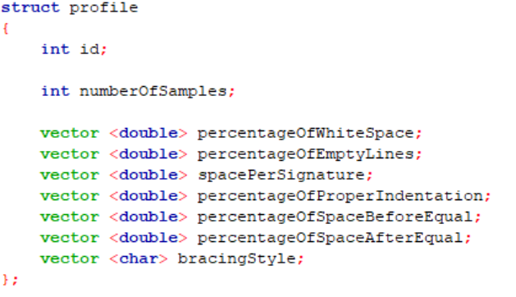
Feature set

Slide 8
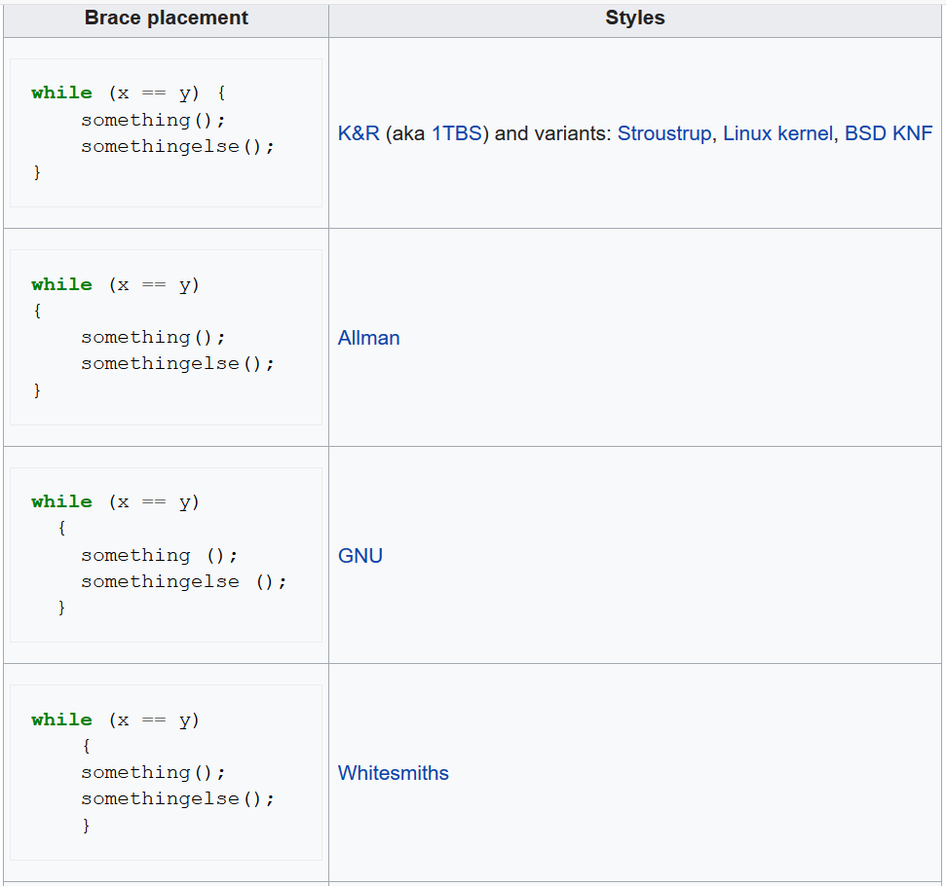
Feature set
Bracing
Styles

Slide 9
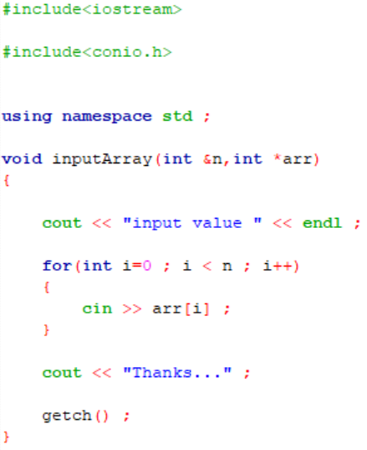
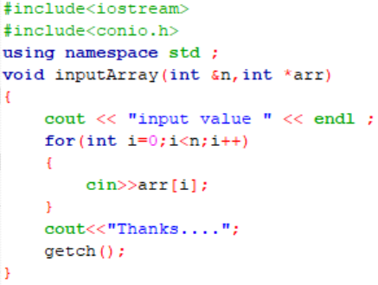
Feature set

Slide 10

Feature set
8 spaces
3 spaces

Slide 11
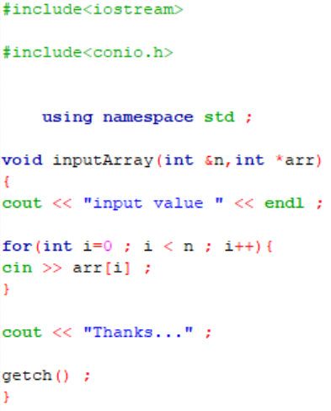
Feature set
Properly indented
Not properly indented

Slide 12
Deanonymization
Statistical measures
Distributional properties of data
Beta distribution
Normal distribution
Ranking technique
Naïve-Bayes
K Means clustering algorithm
Direct reasoning

Slide 13
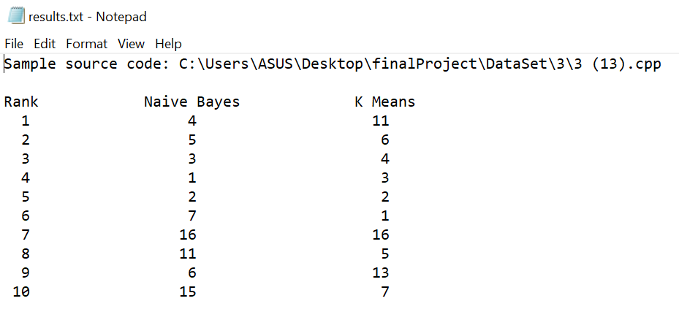
Output presentation

Slide 14
New Learnings
Using user defined headers
Working with several source files
Modularization
Statistical learning (naïve-bayes, beta distribution)
Naïve-Bayes and K Means algorithm

Slide 15
Code
Github repository link:
https://github.com/bsse1006/SPL-1

Slide 16


